Slide 1
DATA SCIENCE · MACHINE LEARNING · CAPSTONE PROJECT
AI Based Student Performance Prediction and Decision Support System with Explainable AI
An explainable machine-learning system for predicting final exam marks, identifying early-warning risk bands, and generating SHAP-guided recommendations.
Team Nemmi Tangha · Oyindrela Das Oitri
Domain: Data Science & Machine Learning

Slide 2
PROBLEM & MOTIVATION
Academic risk is often recognised too late
Motivation for the project, and what the implemented system does about it.
THE PROBLEM (MOTIVATION)
WHAT THIS PROJECT IMPLEMENTS
1
Late identification
Predicts final exam marks (0–100) from five academic indicators
Assigns an early-warning band from the predicted marks
Explains each prediction with SHAP feature contributions
Generates SHAP-guided, feature-level recommendations
Compares hypothetical input scenarios (What-If)
Difficulties often become visible only after final examinations, when little time remains for support.
2
Manual monitoring
Teachers review attendance and marks by hand; early indicators are not combined into a prediction.
3
Limited transparency
Where predictive tools are used, their outputs are often not explained to educators or students.
The problem statements describe the general motivation; they are not results measured by this project.
AI STUDENT PERFORMANCE PREDICTION · DECISION SUPPORT · EXPLAINABLE AI
02

Slide 3
RELATED WORK
Related work & research gap
Positioning of the implemented system. Literature citations are pending verification.
IMPLEMENTED COMBINATION IN THIS PROJECT
VERIFIED REFERENCES REQUIRED BEFORE FINAL SUBMISSION
✓
Performance prediction
Regression of final exam marks
The five studies listed in the earlier draft had no authors, titles, venues or DOIs and could not be verified, so they have been removed.
Add peer-reviewed studies on student performance prediction, early-warning systems and explainable AI in education here once each source has been checked.
The research-gap statement on the right should then be confirmed against those sources.
✓
Early-warning classification
Rule-based bands on predicted marks
✓
SHAP explainability
Feature attribution for each prediction
✓
Feature-level recommendations
Guided by SHAP contributions
✓
What-If scenario analysis
Comparison of model predictions
AI STUDENT PERFORMANCE PREDICTION · DECISION SUPPORT · EXPLAINABLE AI
03

Slide 4
PROJECT OBJECTIVES
What the system is designed to do
All five objectives are implemented in the current system.
1
2
3
4
5
Predict
Identify
Explain
Recommend
Explore
Predict final exam marks from early academic indicators.
Identify students falling into defined early-warning bands.
Explain each prediction using SHAP feature contributions.
Generate SHAP-guided, feature-level recommendations.
Allow hypothetical scenario comparison through What-If analysis.
AI STUDENT PERFORMANCE PREDICTION · DECISION SUPPORT · EXPLAINABLE AI
04

Slide 5
DATASET
Student academic dataset
data/Final_Marks_Data.csv — the only dataset used by the model.
2,000
records (students)
Column | Role | Range in data
Attendance (%) | Input | 52 – 100
Internal Test 1 (out of 40) | Input | 18 – 40
Internal Test 2 (out of 40) | Input | 16 – 40
Assignment Score (out of 10) | Input | 4 – 10
Daily Study Hours | Input | 1 – 5
Final Exam Marks (out of 100) | Target | 25 – 100 (mean 64.86)
Student_ID | Identifier (not a model input) | S1000 – S2999
5
input features
7
columns in total
0–100
target scale (final exam marks)
No missing values · No duplicate students · All features numeric
External dataset origin not verified in the current project documentation.
AI STUDENT PERFORMANCE PREDICTION · DECISION SUPPORT · EXPLAINABLE AI
05

Slide 6
METHODOLOGY
From academic inputs to explained predictions
Prediction pipeline used by the production system, and how the models were evaluated.
Student academic inputs
Input validation
StandardScaler
Linear Regression
1
2
3
4
Feature-level recommendations
SHAP explanation
Early-warning classification
Predicted final exam marks
8
7
6
5
MODEL EVALUATION
WHAT-IF BRANCH
5-fold cross-validation (KFold, shuffle, random_state = 42) with the same folds, features and target for all five candidate models. Scaling is fitted inside each training fold.
Hypothetical inputs follow steps 1–5 through the same prediction endpoint and step 6 for the early-warning band. No SHAP or recommendations are produced for scenarios.
AI STUDENT PERFORMANCE PREDICTION · DECISION SUPPORT · EXPLAINABLE AI
06

Slide 7
SYSTEM ARCHITECTURE
Architecture & technology stack
Three layers connected over HTTP/JSON. No database in the current implementation.
Frontend
React 19 + Vite + Tailwind CSS
FRONTEND
React 19
Vite
Tailwind CSS
HTTP / JSON
BACKEND
Python
Flask
Flask-Cors
Backend
Flask API (Flask-Cors)
GET /
POST /predict
POST /explain
POST /recommend
DATA & ML
Pandas
NumPy
scikit-learn
SHAP
joblib
Model
scikit-learn pipeline (StandardScaler + LinearRegression) + SHAP explainer
No database in the current implementation. Predictions and history are not stored.
AI STUDENT PERFORMANCE PREDICTION · DECISION SUPPORT · EXPLAINABLE AI
07

Slide 8
MODEL COMPARISON
Five regression models on the same 5 folds
5-fold cross-validation, mean ± standard deviation. MAE and RMSE are in final-exam marks out of 100.
Model | MAE | RMSE | R²
Linear Regression (production) | 3.62 ± 0.07 | 4.59 ± 0.09 | 0.8357 ± 0.0084
Random Forest (tuned) | 3.85 ± 0.08 | 4.88 ± 0.09 | 0.8145 ± 0.0053
SVR | 3.91 ± 0.11 | 4.94 ± 0.11 | 0.8099 ± 0.0069
Random Forest | 3.99 ± 0.11 | 5.05 ± 0.10 | 0.8008 ± 0.0063
Decision Tree | 4.85 ± 0.17 | 6.07 ± 0.17 | 0.7123 ± 0.0158
Linear Regression is the production model: it has the lowest MAE, the lowest RMSE and the highest R² of the five reproducible candidates.
Source: results/evaluation.md (evaluate_models.py). XGBoost is not included: the package is not part of the project environment, so it could not be evaluated reproducibly.
AI STUDENT PERFORMANCE PREDICTION · DECISION SUPPORT · EXPLAINABLE AI
08

Slide 9
PRODUCTION MODEL
StandardScaler + Linear Regression
Selected as the production model because it achieved the strongest 5-fold CV performance among the reproducible candidate models.
MAE
RMSE
R²
3.62
4.59
0.8357
± 0.07 marks
± 0.09 marks
± 0.0084
Mean absolute error
Root mean squared error
Coefficient of determination
Five inputs
StandardScaler
LinearRegression
Predicted marks
Trained on all 2,000 records by final_model.py and saved as final_student_performance_model.pkl (scikit-learn 1.9.1). The same model serves /predict, /explain and /recommend.
AI STUDENT PERFORMANCE PREDICTION · DECISION SUPPORT · EXPLAINABLE AI
09

Slide 10
EARLY-WARNING CLASSIFICATION
Early-warning bands on predicted marks
This is a derived early-warning layer on top of a regression model. Results use out-of-fold predictions (5-fold CV).
THRESHOLDS
CONFUSION MATRIX (ACTUAL VS PREDICTED BAND)
High Concern
predicted < 40
Actual \ Predicted | High Concern | Borderline | Lower Concern | Total
Actual < 40 | 13 | 8 | 4 | 25
Actual 40 – 44 | 3 | 12 | 43 | 58
Actual > 44 | 1 | 10 | 1,906 | 1,917
Borderline
predicted 40 – 44
Lower Concern
predicted > 44
13 / 25
21 / 25
0.990
1.25%
High Concern alone
High Concern + Borderline
ROC-AUC (actual < 40)
Actual marks below 40
Recall 52.0% · Precision 76.5%
Broad-warning recall 84.0% · 47 flagged
Ranking quality of predicted marks
25 of 2,000 students
Limitation: class imbalance and regression shrinkage toward the mean limit detection of some low-scoring students. Thresholds were not tuned on these results.
AI STUDENT PERFORMANCE PREDICTION · DECISION SUPPORT · EXPLAINABLE AI
10

Slide 11
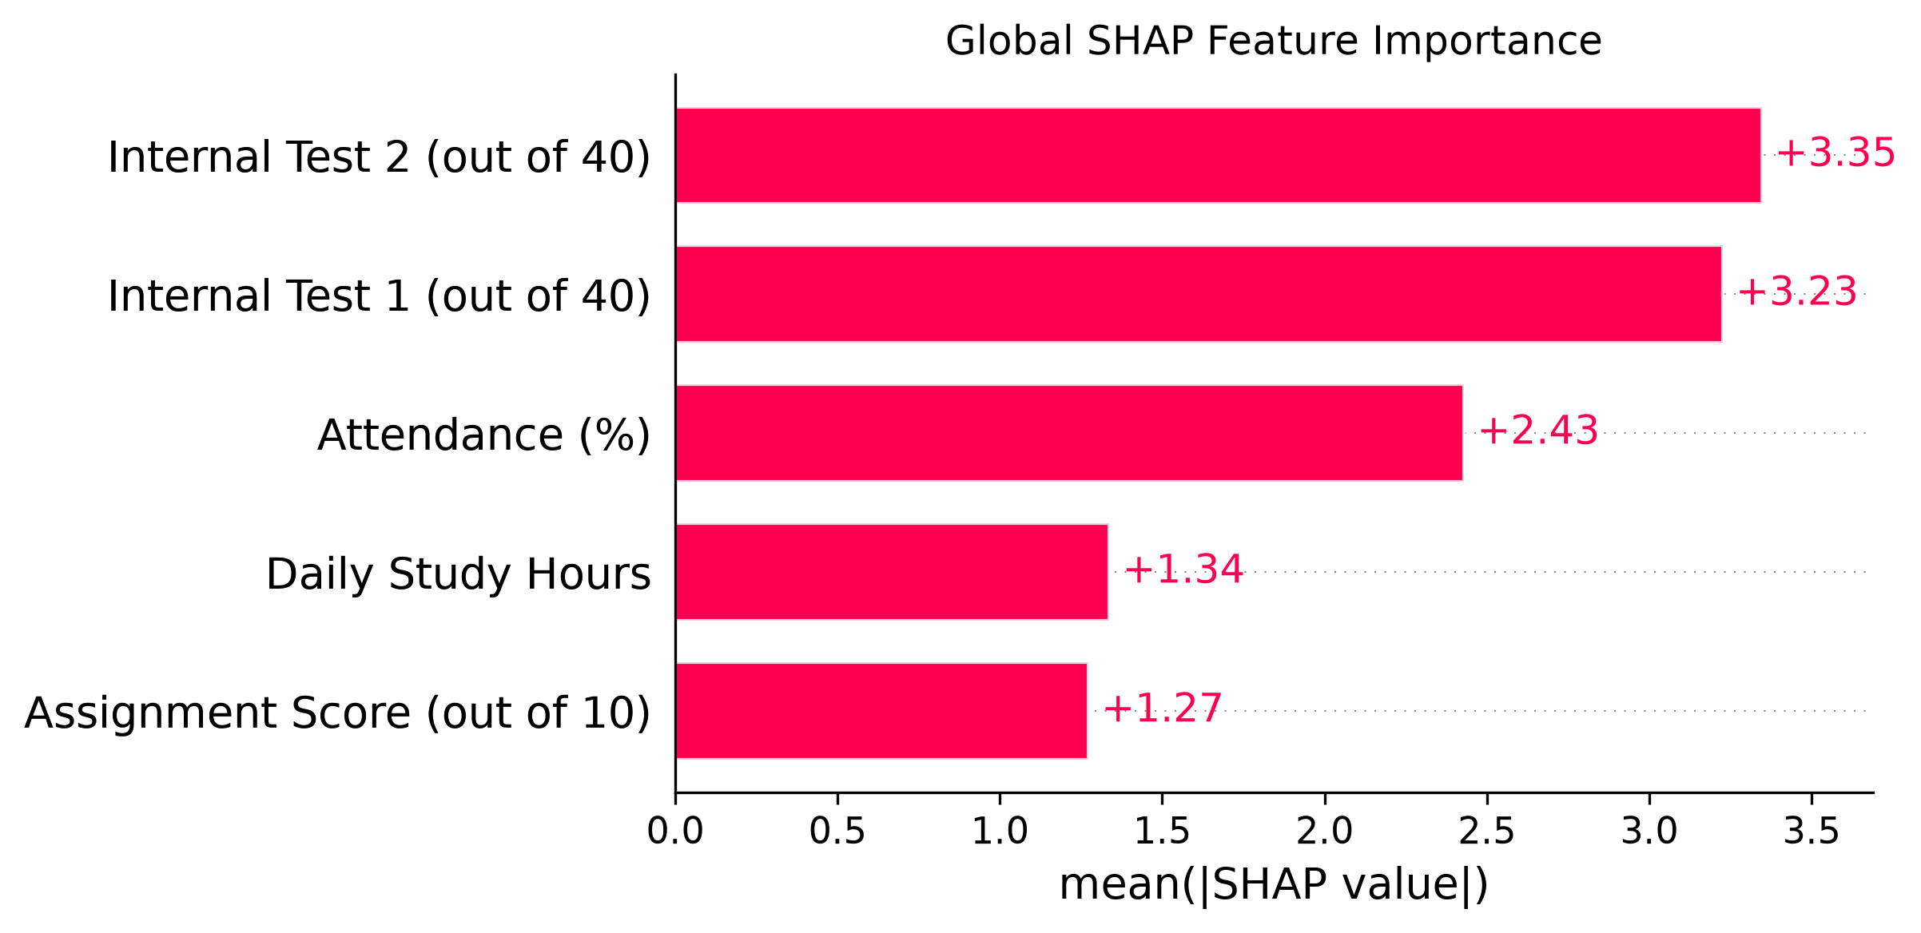
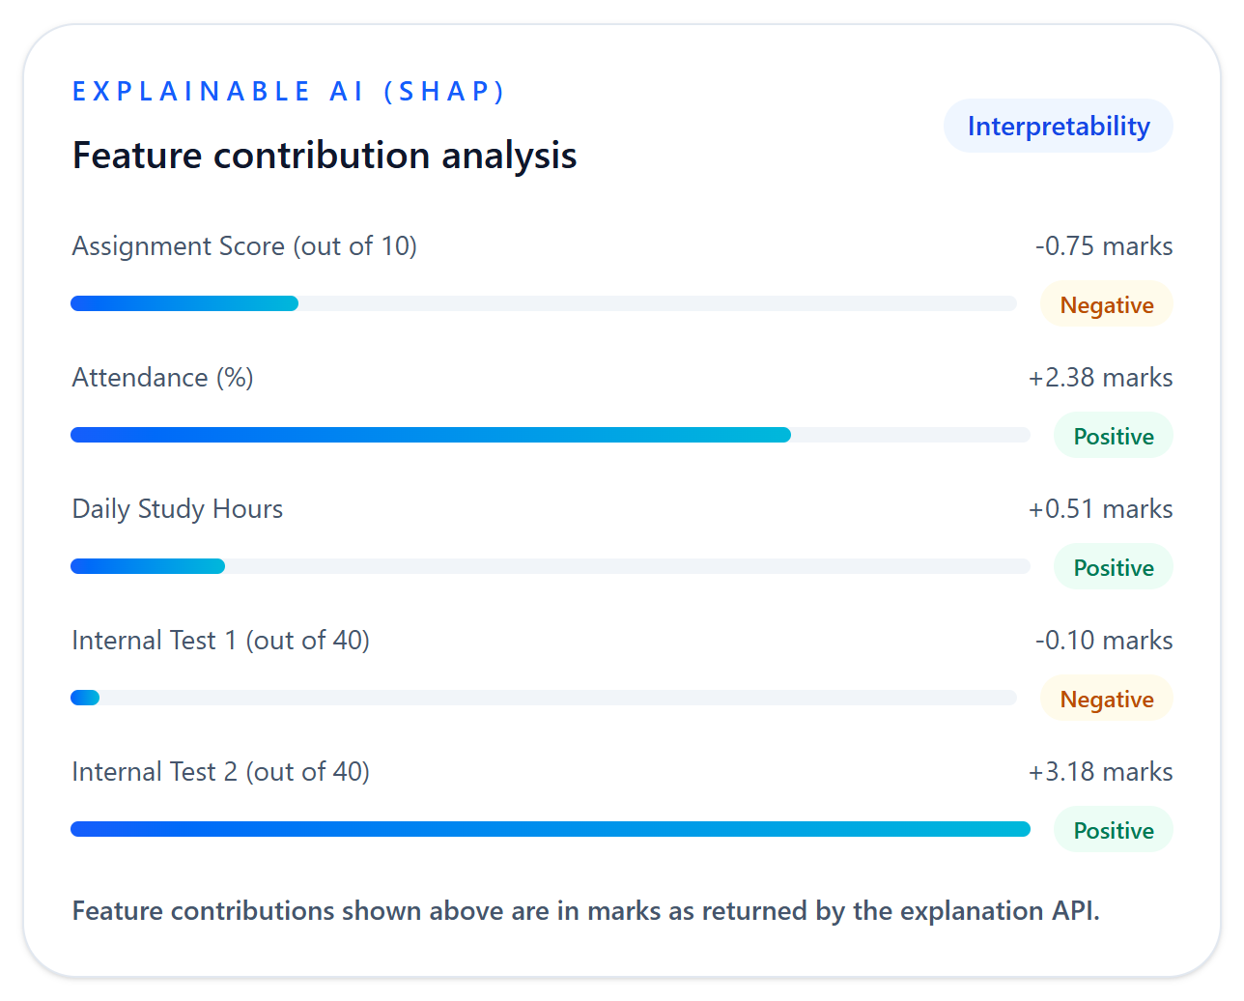
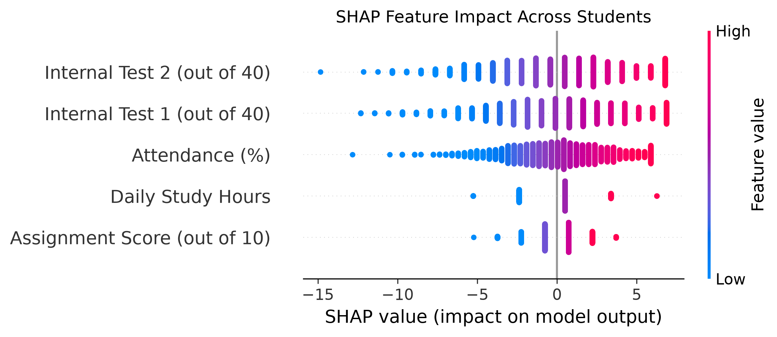
EXPLAINABLE AI
SHAP feature attribution
SHAP attributes the model prediction to input features relative to a baseline (the average prediction).
GLOBAL: MEAN |SHAP| OVER ALL 2,000 STUDENTS (MARKS)
ONE PREDICTION (STANDARD INPUT 91, 32, 36, 7, 3)
Base value
64.855
+ contributions
+5.22
= prediction
70.07
DISTRIBUTION ACROSS STUDENTS
Each dot is one student; colour is the feature value. Feature names are the model inputs.
SHAP explains how the model arrived at a prediction. It does not show that an input caused a student's performance, and it does not predict what would happen if an input changed.
AI STUDENT PERFORMANCE PREDICTION · DECISION SUPPORT · EXPLAINABLE AI
11

Slide 12
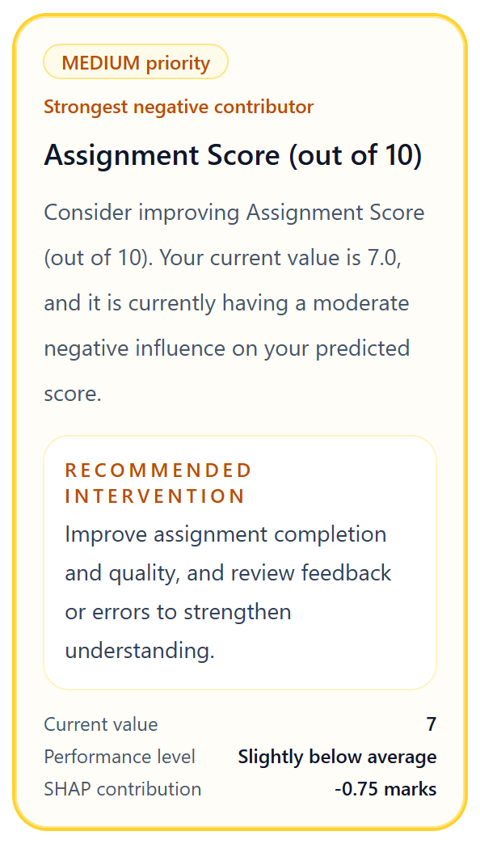
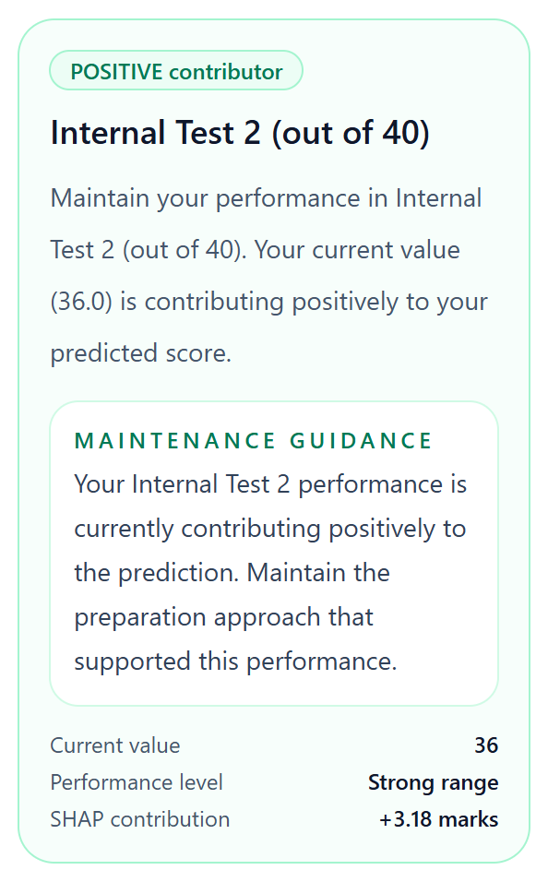
RECOMMENDATION ENGINE
SHAP-guided, feature-level recommendations
Recommendations are SHAP-guided and feature-level: fixed rules applied to each feature's SHAP contribution.
Prediction + SHAP contributions
REAL OUTPUT FOR THE STANDARD INPUT (91, 32, 36, 7, 3)
Negative contributors are listed first, ordered by the size of their SHAP contribution; positive contributors follow as maintenance guidance.
Each item shows the feature, priority, current value, performance level, SHAP contribution and a predefined action.
Actions are predefined academic guidance per feature — not individual study plans.
Threshold-based rules
Feature-level recommendations
SHAP contribution | Priority
below −1.0 marks | HIGH
−1.0 to below −0.5 | MEDIUM
−0.5 to +0.5 | no recommendation
above +0.5 marks | POSITIVE (maintenance)
AI STUDENT PERFORMANCE PREDICTION · DECISION SUPPORT · EXPLAINABLE AI
12

Slide 13
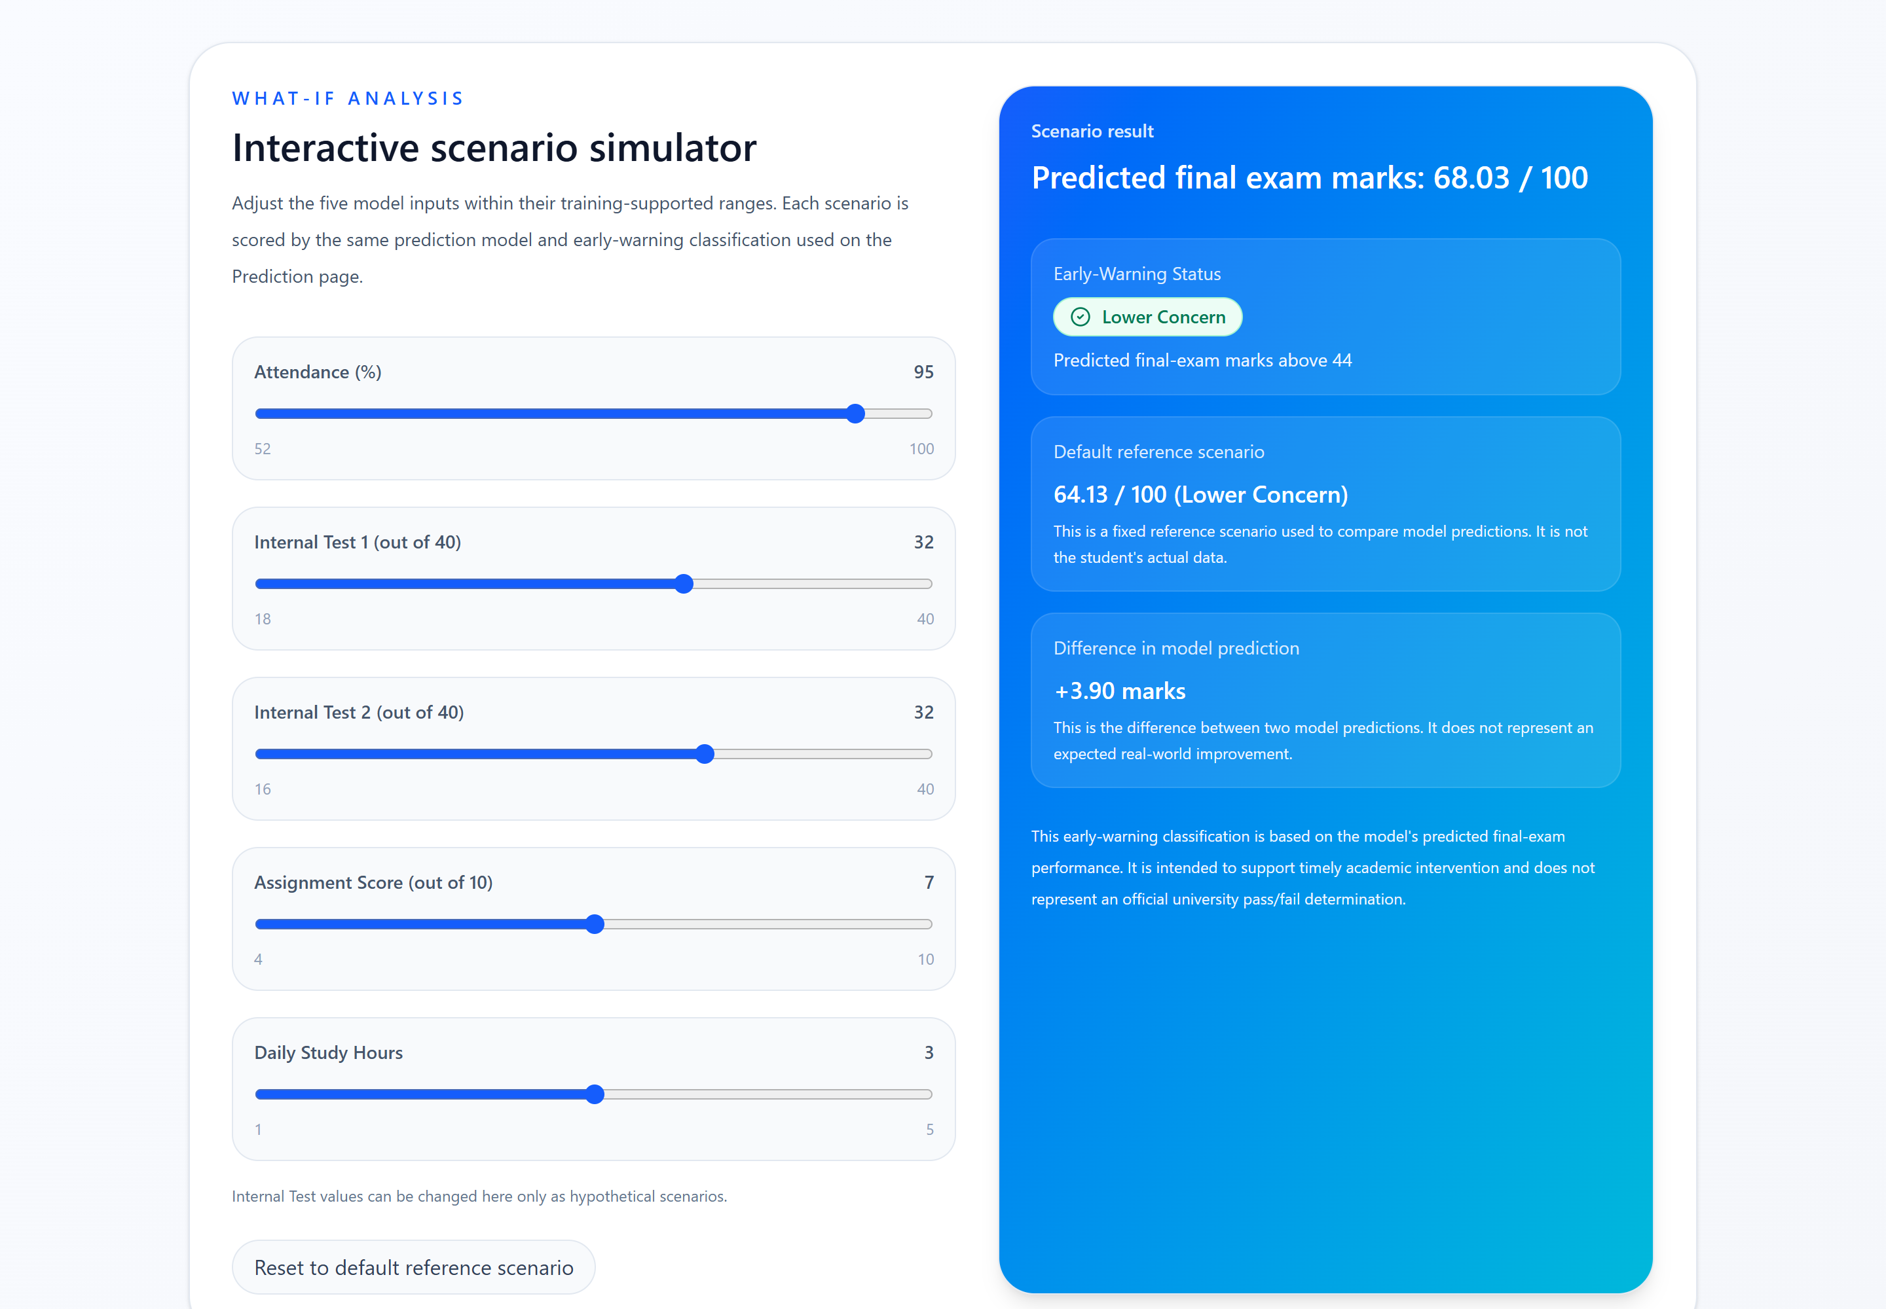
WHAT-IF SIMULATOR
What-If scenario simulator
Real screen: attendance changed from 85 to 95, other inputs at the default reference scenario.
1
User changes hypothetical input values
2
The scenario is sent to /predict (same production model)
3
The model returns new predicted marks
4
The simulator displays the early-warning category
5
Difference in model prediction vs the fixed default reference scenario
This represents a model prediction difference, not a guaranteed real-world improvement. Example above: 64.13 → 68.03, difference +3.90 marks.
AI STUDENT PERFORMANCE PREDICTION · DECISION SUPPORT · EXPLAINABLE AI
13

Slide 14
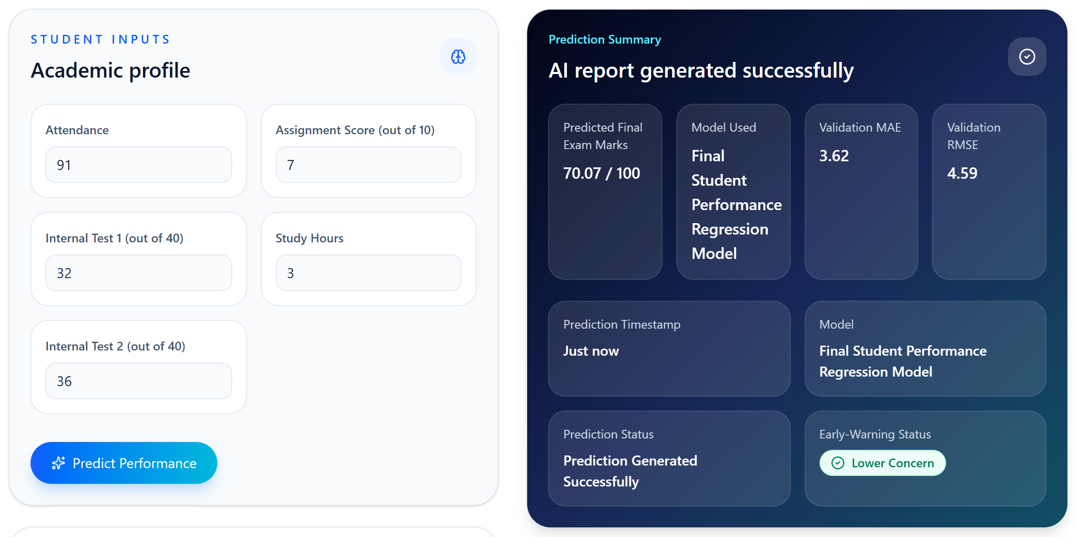
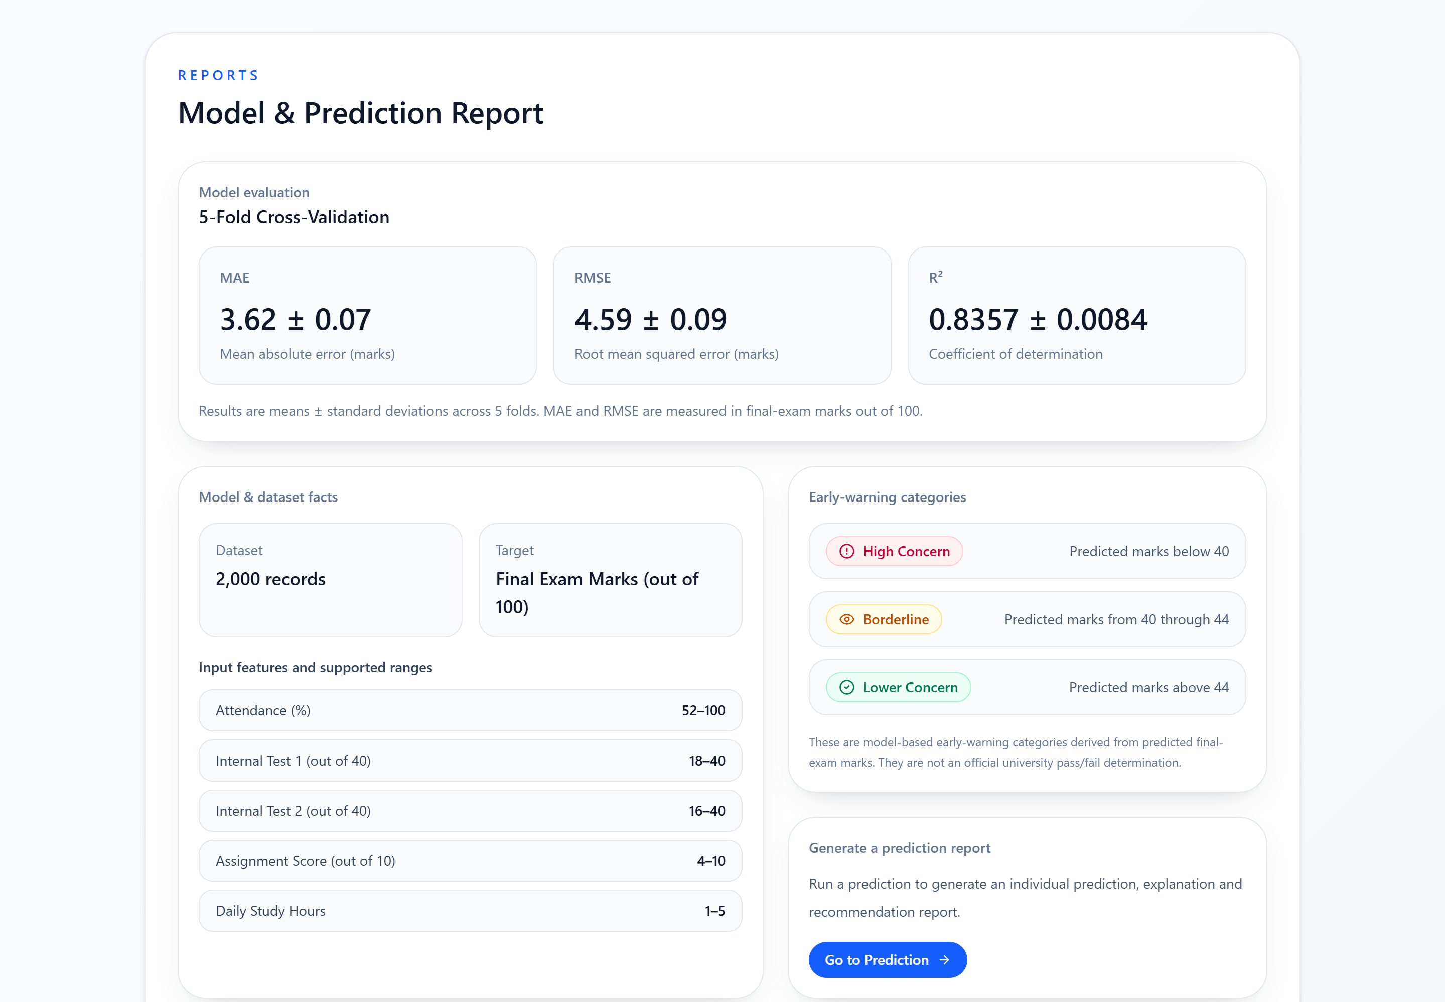
SYSTEM DEMONSTRATION
The running application
Screenshots captured from the current implementation (standard input 91, 32, 36, 7, 3).
Reports page — 5-fold CV metrics, dataset facts and early-warning categories
Prediction page — inputs, predicted marks (70.07 / 100) and early-warning status
SHAP contributions and recommendations for the same prediction are shown on slides 11 and 12. The faculty dashboard is not shown because it has no connected student data.
AI STUDENT PERFORMANCE PREDICTION · DECISION SUPPORT · EXPLAINABLE AI
14

Slide 15
LIMITATIONS
Limitations of the current system
Stated so that the results are interpreted within their scope.
Data & model
Early warning
Dataset external origin not verified
Only five academic input features
No demographic variables, so no fairness or bias analysis
Model performance is based on this dataset only
Class imbalance: 1.25% of students scored below 40
High Concern recall is limited to 52%
High + Borderline improves recall to 84% but flags more students (47)
Low scores are predicted closer to the mean
Interpretation
System
SHAP provides model attribution, not causation
What-If provides scenario comparison, not intervention effects
No database or prediction history
No real authentication
Faculty dashboard is a prototype without connected data
AI STUDENT PERFORMANCE PREDICTION · DECISION SUPPORT · EXPLAINABLE AI
15

Slide 16
FUTURE SCOPE
Planned extensions (not implemented)
Everything on this slide is future work. None of it is part of the current system.
Data & model
Platform
Extensions
Verified and larger datasets
Additional validated features
Validated threshold calibration
Fairness evaluation once suitable demographic data is available
Database and prediction history
Real authentication and role management
Connected faculty analytics
Real-time data integration / API
Mobile application
NLP-based feedback
AI STUDENT PERFORMANCE PREDICTION · DECISION SUPPORT · EXPLAINABLE AI
16

Slide 17
REFERENCES
References
References to be finalized from verified sources.
METHODS AND SOFTWARE USED BY THE SYSTEM
Lundberg, S. M., & Lee, S.-I. (2017). A unified approach to interpreting model predictions. Advances in Neural Information Processing Systems 30 (NeurIPS 2017).
Pedregosa, F., et al. (2011). Scikit-learn: Machine learning in Python. Journal of Machine Learning Research, 12, 2825–2830.
LITERATURE REVIEW — REFERENCES TO BE FINALIZED FROM VERIFIED SOURCES
The related-work studies from the earlier draft could not be verified and are not listed. Add full citations (authors, title, venue, year, DOI) for each study used on the Related Work slide before final submission.
AI STUDENT PERFORMANCE PREDICTION · DECISION SUPPORT · EXPLAINABLE AI
17

